Slide 1
Self-Assembly
Materials that make themselves are beginning to make their presence felt as novel drug-delivery vehicles and electronic components
INTRODUCTION
Assembling molecules into complex structures:
Natural
Man-Made (Materials Scientists)
For example, chemists and clams. Both make high-strength ceramic composites.
Chemists make use of crude methods-including extreme temperatures and the use of molds-to fuse neighboring molecules into specific shapes.
The mollusks engineer a shiny, tough mother-of-pearl shell by using a series of proteins that assemble themselves into a scaffolding.
The scaffolding guides tiny ceramic plates, created by the mollusk, into precise shell layers.

Slide 2
INTRODUCTION
Biological organisms can organize structures by themselves at the angstrom, micron, and centimeter level.
Materials scientists are increasingly attempting to use such materials that make themselves, being inspired from nature.
The man made self assembled structures are still at the beginning stages and is growing up fast.
Although scientists are no-where near duplicating the nature's more elegant self-assemblies but they have already begun to register their first practical success.

Slide 3
INTRODUCTION
Several drug companies are in late-stage clinical trials with self-assembled microscopic vesicles that can carry potentially life saving drugs to cancer patients.
And by the use of organic, metal, and phosphonate molecules (complexes of phosphorus and oxygen atoms derived from phosphonic acid H₃PO₃), to assemble themselves into conducting materials, researchers are turning electronic fabrication into a benchtop affair.

Slide 4
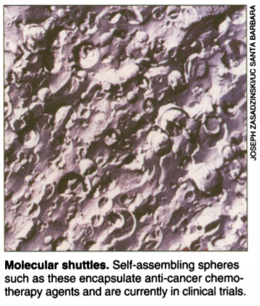
Applications:
Delivery Molecules
Today, self-assembly appears to be coming together most quickly in drug delivery.
But, medical shuttles must ward off the destructive attacks set in motion by metabolic processes.

Slide 5
Applications:
Drug Carriers
Self-assembly gives researchers a tool to quickly and easily manufacture microscopic structures
to protect these drugs in a hope that they can remain active in the body for longer periods, from days to weeks.
As early as the 1960s, researchers realized that one possible way to sneak drugs into the body would be to hide them in a material imitating the membranes that make up the body's own cells and vesicles.
These membranes are largely made of phospholipid molecules, which have balloon-like head groups that are attracted to water, and tails made up of long hydrocarbon chains that flee from water's presence.

Slide 6
Applications:
Drug Carriers
By dissolving therapeutic drugs in the water at the start of this process, researchers were able to use these "lipid bilayers" as drug carriers, which can vary in size from 25 nanometers to more than a micron.
The drugs were released either by slowly leaking out through the porous membranes or all at once when the bilayers ruptured.

Slide 7
Applications:
Trial, error, success
Even though the idea of spheres carrying anti-cancer drugs was appealing, and were heavily hyped as a way to beat the disease, early versions of these self-assembling drug carriers had problems of being attacked by immune cells called macrophages.
The mechanism of recognition by the immune cells isn’t clear.
It is most likely due to proteins in blood plasma that attached themselves to the spheres, tagging them for removal by macrophages.

Slide 8
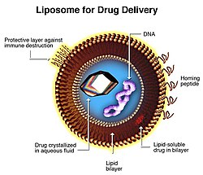
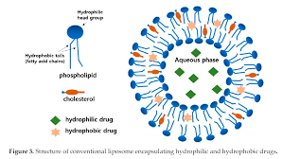

Slide 9
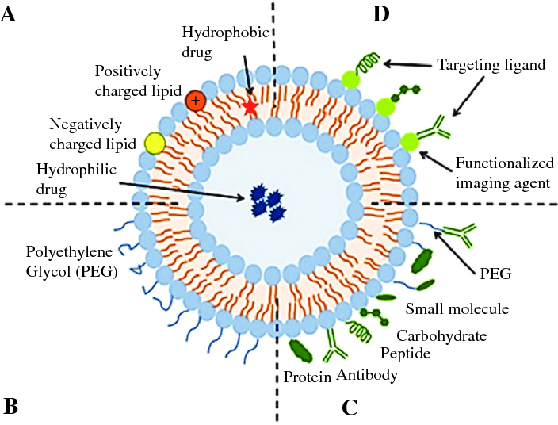

Slide 10
Applications:
Trial, error, success
Natural membranes and vesicles escape this fate because they incorporate other molecules, such as glycoproteins and carbohydrates. (RBCs life span is 120 days)
These modifications stick out of the membrane and apparently help shield them from attachment by proteins.

Slide 11
Applications:
Trial, error, success
In the late 1980s, when two independent groups, led by Demetrios Papahadjopoulos, a biophysicist at the University of California at San Francisco, and Terry Allen at the University of Alberta in Edmonton, began mimicking the protection that natural membranes use by incorporating glycolipids into the liposomes.
It worked: In animal tests the liposomes escaped assault by macrophages.
In the last few years academic and biotechnology company researchers have pulled off the same trick using synthetic glycolipids such as polyethyleneglycol (PEG).

Slide 12
Applications:
Trial, error, success
Based on that and other successes, liposomes are now being employed as transport vehicles for several different types of drugs.
In early trials on animals, two companies Liposome Technologies of Menlo Park, California, and The Liposome Company of Princeton, New Jersey have shown that encasing the anti-cancer drug doxorubicin in liposomes and injecting it into cancer stricken mice can increase survival rates of the mice over others that receive the drug all by itself.

Slide 13
Applications:
Further Enhancements
Liposomes now look promising for drug delivery, and are being further modified to specifically target a tumor and deliver their cargo just to the tumor cells.
And that approach called as "targeted spheres” for targeted delivery.
Example: attachment of an antibody for mammalian squamous-cell carcinoma to a sphere that successfully attacked lung tumor cells in mice.
Robert Langer at the Massachusetts Institute of Technology tried to self-assemble drug-carrying spheres out of polymers, some of which may break down more slowly, thereby releasing their contents over a longer period of time.
Increased Shelf- Life.

